Slide 1
Module V:
Introduction to Neural Networks, shallow and deep
Future?
We are currently kind
of at this point in time
source: datanami.com, towardsdatascience.com, Tom Gauld’s tweet

Slide 2
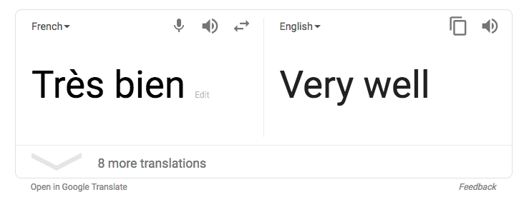
Deep learning is transforming (almost) everything!
source: newscientist.com, bestbuy.com, medium.com, google.com
Diagnosis without doctors, radiology
Apple face id, iPhone 10x
Amazon Alexa, speech recognition
Google autotranslate, language translation

Slide 3
Why is Deep Learning so transformative — I
Data: structured and unstructured
Feature Detector/extractor
and/or Domain-specific
feature Engineering
Linear regression,
logistic regression,
Support Vector Machines,
Random Forests, etc…
Deep Neural Networks
Classical machine learning:
Predictive and/or interpretable model
Deep Learning:
Predictive model
Source: SearchEnterpriseAI-TechTarget, myonlinetraininghub.com, Machine Learning Mastery, Yann LeCun et al, 2015

Slide 4
Why is Deep Learning so transformative — II
More Data = More Performance only for DL !
Repeating linear and non-linear units can
make an infinitely flexible function
AKA Universal Approximation Theorem
Source: https://medium.com/@srnghn/introduction-to-deep-learning-what-do-i-need-to-know-75794ebc4a62, arXiv:1806.10909v2 4 Jul 2018

Slide 5
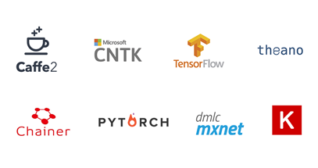
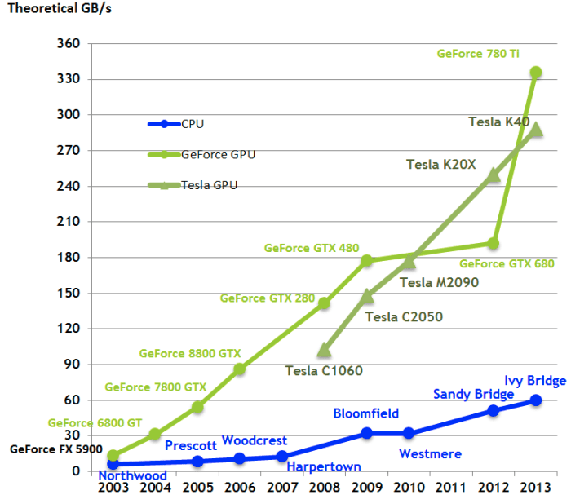
OK, DL is great! What do we need to train a DNN ?
The DL framework or package
Suitable compute
Large data either locally or
Less data with transfer learning !
Source: nvidia, https://medium.com/@shachishah.ce/do-we-really-need-gpu-for-deep-learning-47042c02efe2, SoftwareLogy

Slide 6
Links to specific DL libraries (Python)
https://keras.io/#installation
https://pytorch.org/get-started/locally/
https://caffe2.ai/docs/getting-started.html?platform=mac&configuration=prebuilt
Source: blog.keras.io, pytorch.org, caffe2.ai

Slide 7
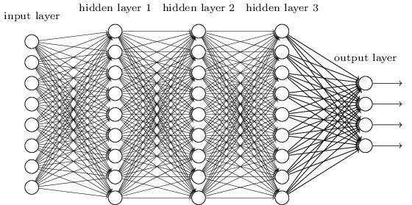
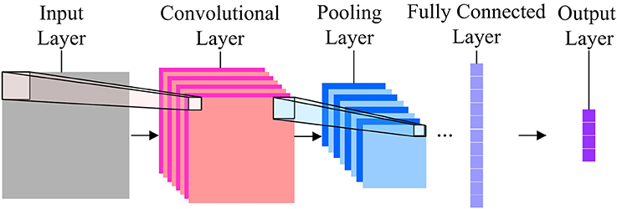
Different DNN architectures
Convolutional neural networks (CNNs) for
image and speech recognition
Densely or fully connected (fc)
neural networks
Recurrent neural nets (RNNs),
LSTMs, sequence models for
Hybrid and other architectures
Covered in this class
Source: frontiers.org, neuralnetworksanddeeplearning.com,towardsdatascience.com, ResearchGate

Slide 8

DNN — basic algorithm
Goal : Convert X vector into Y vector
Step I: linearly transform (a.k.a matrix multiply)
Input vector
Step II: Non-linearly squish output from step I
to calculate the activations vector
Matrices
initialized
With
random
numbers
to begin with!
Update matrices
using
Stochastic
gradient
Descent (SGD)
Step III: Feed forward the activations vector
To more repetitions of linear transform and
non-linear squish
Step IV: Use final layer to predict Y
Stop updating
Matrices
When the error
No longer
Decreases
Step V: Calculate the difference or error between
predicted Y and actual Y
Step VI: Calculate derivative of error
w.r.t each number in each matrix &
back propagate them!
Final
Predicted
Output Y vectors

